Slide 1
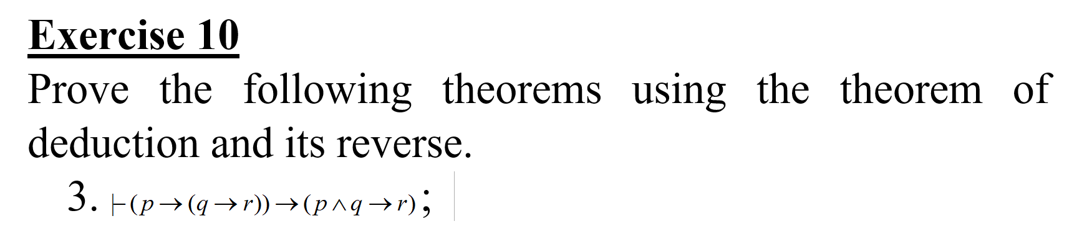
Problem statement

Slide 2
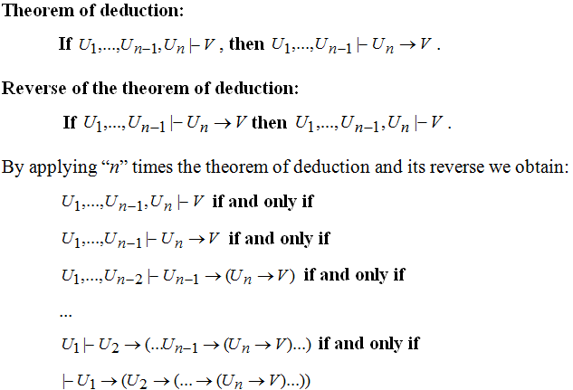
Theoretical results

Slide 3
Use the theorem of deduction and its reverse prove:
⊢ (p → (q → r)) → (p ∧ q → r)
STEP 1: We apply the reverse or the theorem of deduction to obtain the initial deduction.
The premise of the main implication is moved from right to the left.
if ⊢ (p → (q → r)) → (p ∧ q → r) then
p → (q → r) ⊢ p ∧ q → r then
p → (q → r), p ∧ q ⊢ r

Slide 4
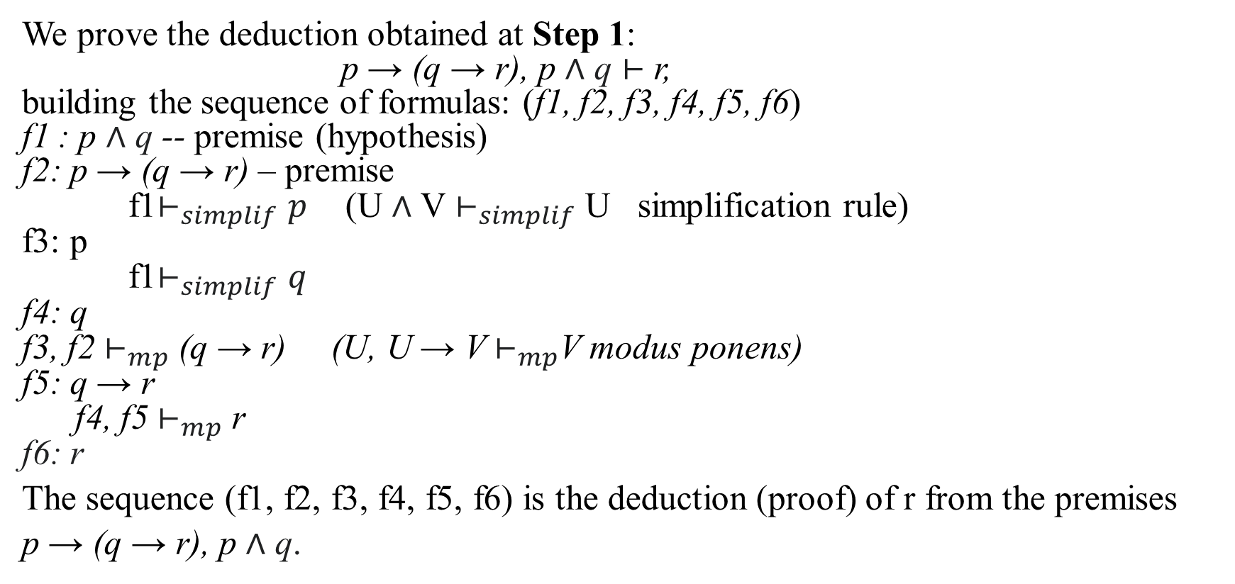
STEP 2:
We prove the deduction obtained at Step 1:
p → (q → r), p ∧ q ⊢ r,
building the sequence of formulas: (f1, f2, f3, f4, f5, f6)
f1 : p ∧ q -- premise (hypothesis)
f2: p → (q → r) – premise
f1${\text{⊢}}_{simplif}p$ (U ∧ V ${\text{⊢}}_{simplif}$ U simplification rule)
f3: p
f1${\text{⊢}}_{simplif}q$
f4: q
f3, f2 ${\text{⊢}}_{mp}$ (q → r) (U, U → V ${\text{⊢}}_{mp}$V modus ponens)
f5: q → r
f4, f5 ${\text{⊢}}_{mp}$ r
f6: r
The sequence (f1, f2, f3, f4, f5, f6) is the deduction (proof) of r from the premises
p → (q → r), p ∧ q.

Slide 5
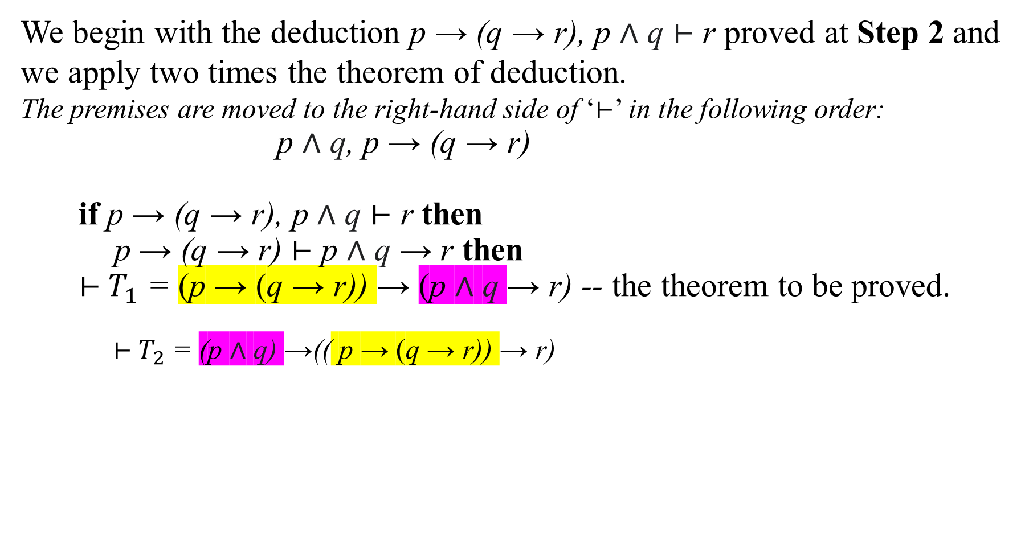
STEP 3:
We begin with the deduction p → (q → r), p ∧ q ⊢ r proved at Step 2 and we apply two times the theorem of deduction.
The premises are moved to the right-hand side of ‘⊢’ in the following order:
p ∧ q, p → (q → r)
if p → (q → r), p ∧ q ⊢ r then
p → (q → r) ⊢ p ∧ q → r then
⊢${ T}_{1}$ = (p → (q → r)) → (p ∧ q → r) -- the theorem to be proved.
⊢${ T}_{2}$ = (p ∧ q) →(( p → (q → r)) → r)

